Slide 1
WOODLAND SCHOOL DISTRICT 2024-2025 YEAR END FINANCIAL SUMMARY
Presented by:
Stacy Brown
Exec Director of Business Services

Slide 2
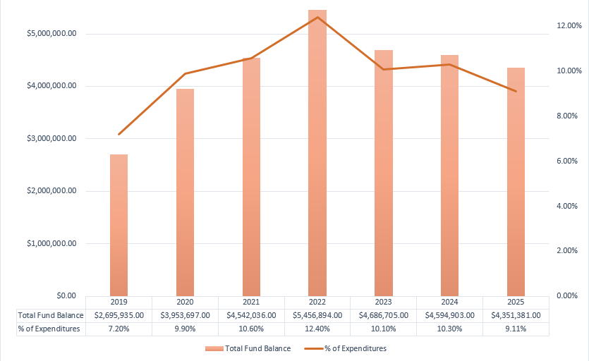
History of Total Fund Balance at Year-End and the Percentage of Budgeted Expenditures

Slide 3
Fund Balance/Enrollment
 | August 31, 2025 | August 31, 2024
Total Ending Fund Balance | $ 4,351,381 | $ 4,594,903
Restricted for Pgm Carryover | $ 2,921 | $ 0
Nonspendable for Prepaid Exp | $ 298,479 | $ 80,817
Assigned for Building/Dept CO | $ 240,301 | $ 316,858
Unassigned Fund Bal | $ 3,809,680 | $ 4,197,228
Unreserved FB Decrease 23-24 to 24-25 | ($ 387,548) | ($ 128,040)
Overall Change in Fund Balance | ($ 243,522) | ($ 91,802)
Budgeted Inc/(Dec) in FB | ($ 696,889) | ($ 709,119)
Actual Ending FB Greater than Budgeted | $ 453,667 | $ 617,317
Budgeted Enrollment | 2,369.00 | 2,348.00
Actual Enrollment | 2,368.11 | 2,351.11

Slide 4
Items that Directly Affect Fund Balance These are revenues greater or less than budget that do not have offsetting expenditures and expenditure items greater or less than budget that do not have offsetting revenues
 | August 31, 2025
Local Taxes Greater than Budget | $ 237,158
Timber Excise Greater than Budget | $ 24,659
Legislative One-Time $50/Student Allocation | $ 114,000
Paying 24-25 Bus Payment Deferred to 25-26 (per Budget) | ($ 117,000)
Woodland Portion of KWRL Unfunded/Utilities Less Than Budget | $ 16,700
Special Education Revenues Greater than Budget ($205,000) and Special Education Expenditures Less than Budget ($173,000) | $ 378,000
Food Service Revenues Less than Budget and Expenditures Greater Than Budget | ($ 66,000)
WCC Revenues Greater than Budgeted ($24,000) and Expenditures Less than Budget ($16,000) | $ 40,000
Cert and Classified Subs Greater than Budgeted | ($ 65,000)
Investment Interest Less than Budgeted | ($ 65,000)
ESD112 Risk Pool Rebate | $ 89,000
Summer Maintenance Projects | ($ 120,000)
State Transitional Bilingual Revenues Greater than Budget | $ 31,000

Slide 5
Items that Directly Affect Fund Balance These are revenues greater or less than budget that do not have offsetting expenditures and expenditure items greater or less than budget that do not have offsetting revenues
 | August 31, 2025
Local Taxes Greater than Budget | $ 237,158
Timber Excise Greater than Budget | $ 24,659
Legislative One-Time $50/Student Allocation | $ 114,000
Paying 24-25 Bus Payment Deferred to 25-26 (per Budget) | ($ 117,000)
Woodland Portion of KWRL Unfunded/Utilities Less Than Budget | $ 16,700
Special Education Revenues Greater than Budget ($205,000) and Special Education Expenditures Less than Budget ($173,000) | $ 378,000
Food Service Revenues Less than Budget and Expenditures Greater Than Budget | ($ 66,000)
WCC Revenues Greater than Budgeted ($24,000) and Expenditures Less than Budget ($16,000) | $ 40,000
Cert and Classified Subs Greater than Budgeted | ($ 65,000)
Investment Interest Less than Budgeted | ($ 65,000)
ESD112 Risk Pool Rebate | $ 89,000
Summer Maintenance Projects | ($ 120,000)
State Transitional Bilingual Revenues Greater than Budget | $ 31,000

Slide 6
Levy/Local Funds
Expenditure Type | Levy Dollars 2024-2025 | Levy Dollars 2023-2024
Certificated Salaries | $ 785,000 | $ 640,000
Classified Salaries | $ 1,334,500 | $ 1,273,000
Administrator Salaries | $ 245,500 | $ 275,000
Substitutes | $ 336,000 | $ 338,000
Benefits | $ 397,000 | $ 675,000
Supplies/Services/Travel/Utilities/Insurance | $ 207,500 | $ 467,000
Extracurricular | $ 572,600 | $ 344,517
Special Education | $ 482,000 | $ 290,000
Food Service Program | $ 190,000 | $ 43,662
To/From Transportation/Bus Purchase | $ 310,500 | $ 262,790
Daycare | $ 31,500 | $ 22,049
Family Resource Center | $5,600 | $ 8,115

Slide 7
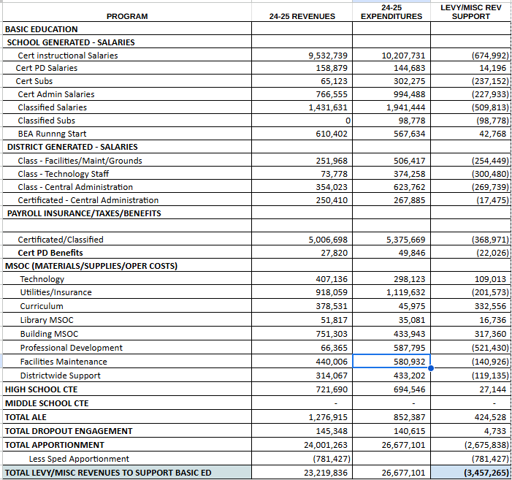
Detailed Levy Support – Apportionment Funded Pgms

Slide 8
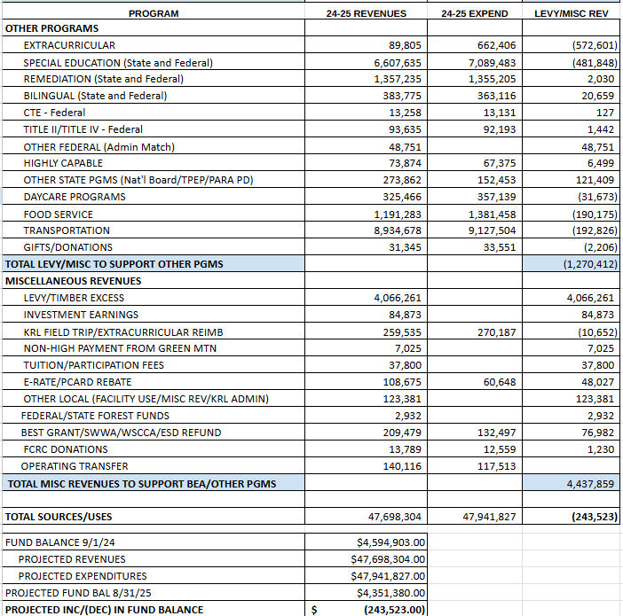
Detailed Levy Support – Other Pgms

Slide 9
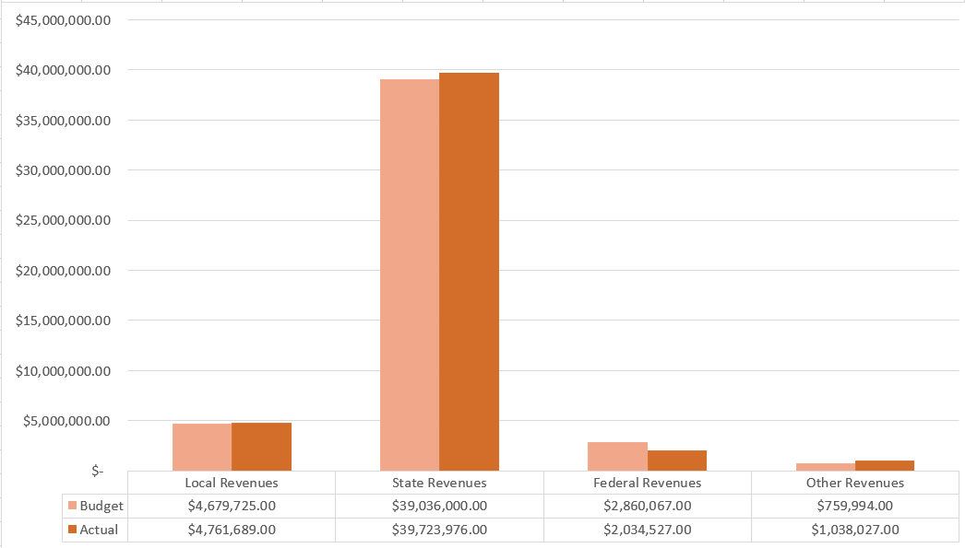
GF Revenues – Budget Compared to Actual

Slide 10
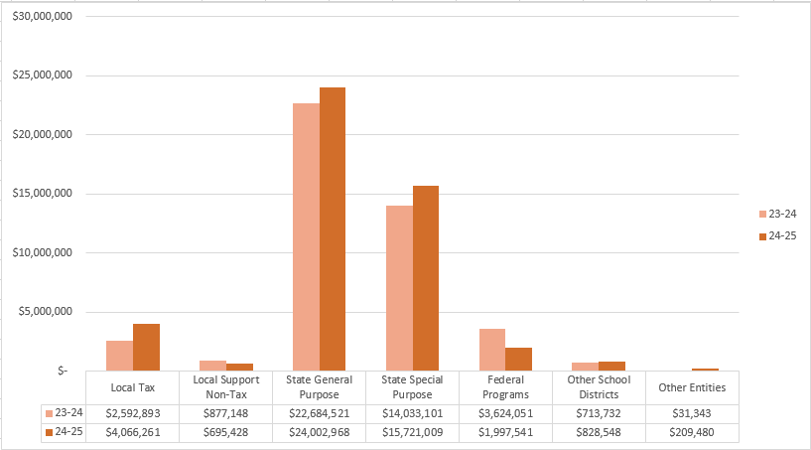
Revenues Compared to Prior Year

Slide 11
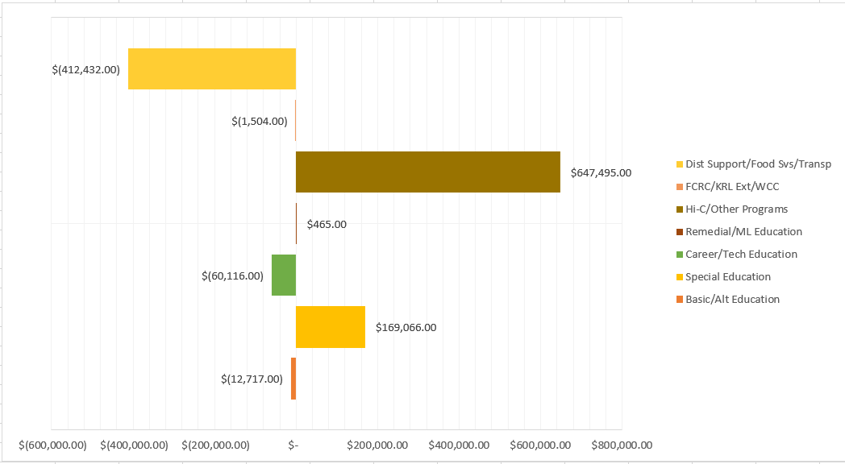
GF Program Expenditures – Variance to Budget

Slide 12
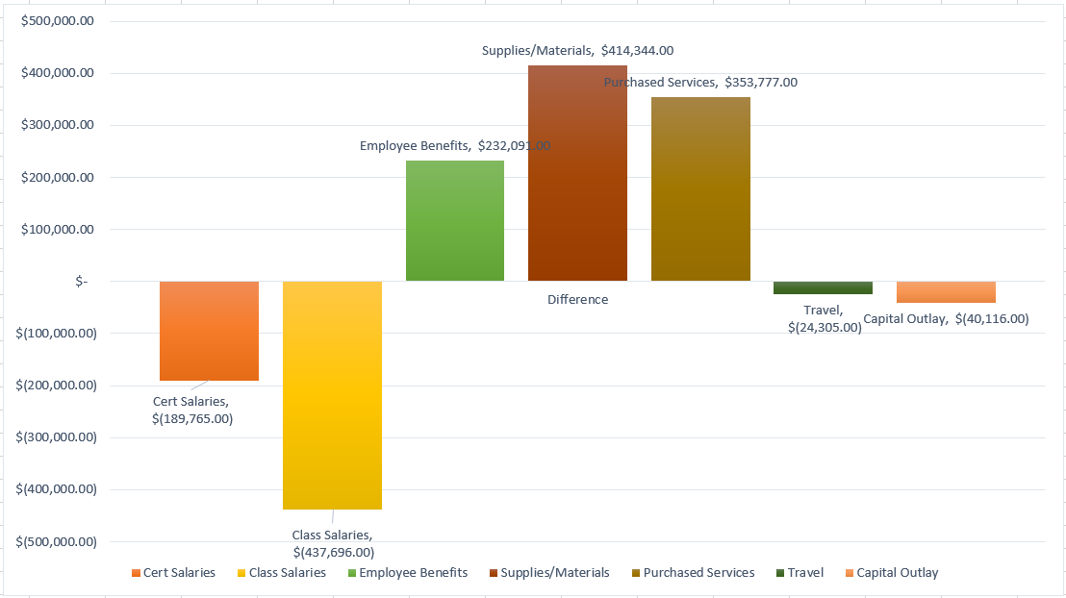
GF Object Expenditures – Variance to Budget

Slide 13
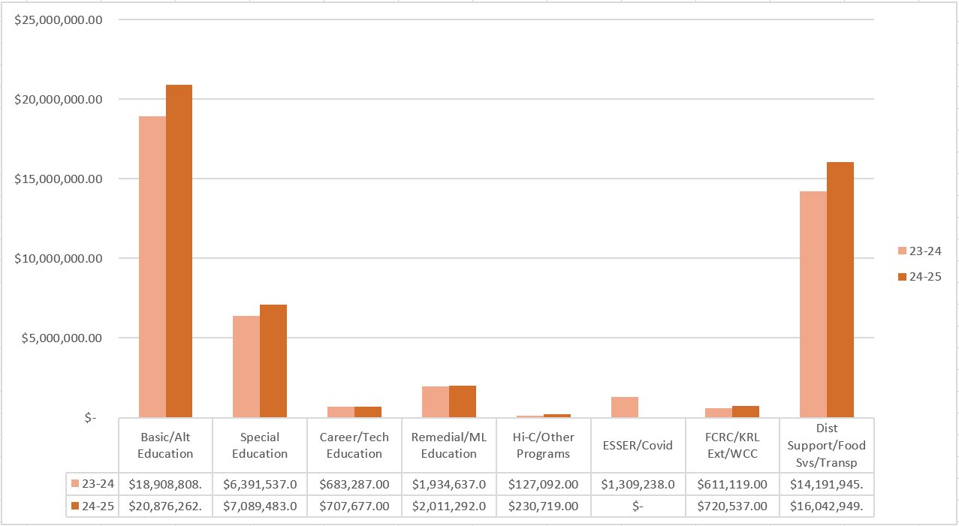
Program Expenditures Compared to Prior Year

Slide 14
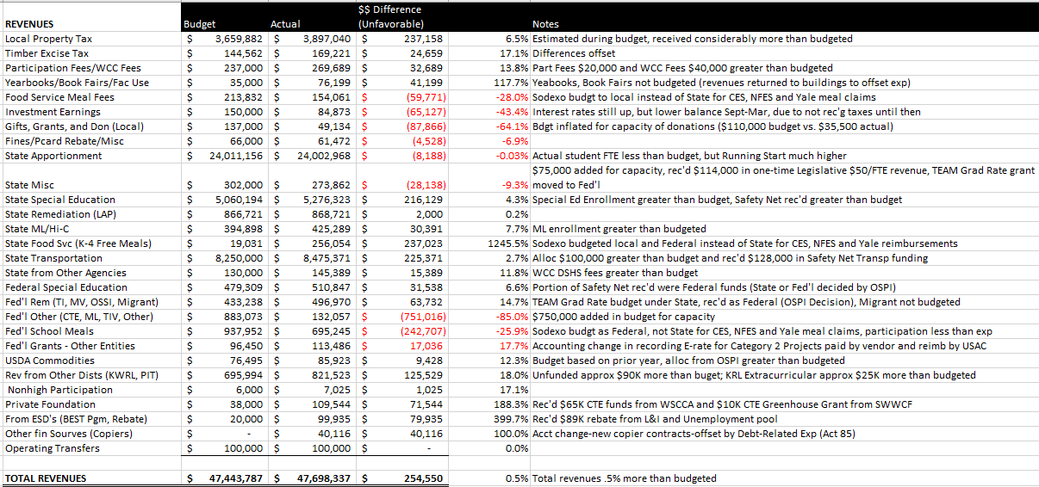
Detail Revenues Compared to Budget

Slide 15
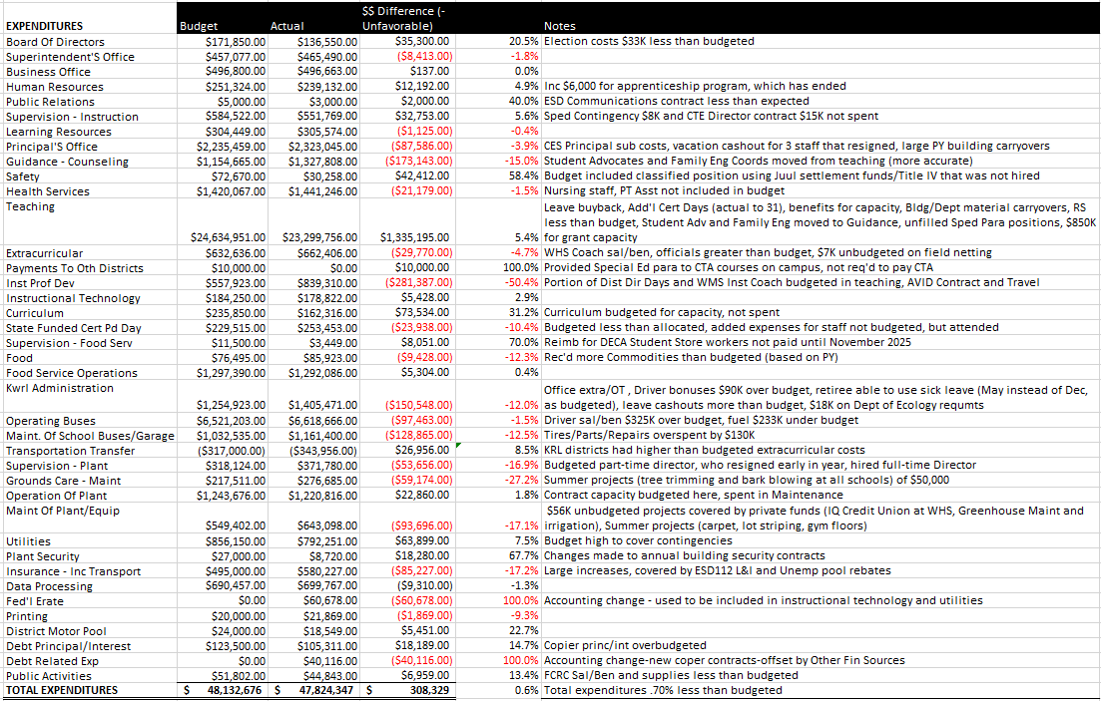
Detailed Expenditures (by Activity) Compared to Budget

Slide 16
Transportation & Food Service
Transportation
Food Service
Total Students transported = Approx 7,700 average per day and 503 Special Ed/Homeless per day average
Total Transp Exp/Util $9,132,000
Total Revenues $8,500,000
Total Unfunded/Util for year was $632,000 Budgeted unfunded plus utilities was $669,600. State Allocation was $97,000 more than budgeted, we received $129,000 in Safety Net Transportation and allocated $25,000 of the ESD Rebate to KWRL. However, total expenditures plus utilities were $213,000 greater than budgeted.
Woodland’s portion of unfunded and utilities was $189,000 which represents 29.91% ownership of the Co-Op compared to 30.82% from 23-24.
Bus contribution for year $117,513 (not budgeted, but decided to use one-time $50/student allocation to make the payment in 24-25 instead of waiting until 25-26.
Total Meals Served = 72,776 Breakfasts (average of 404 per day and an increase from 235 last year) and 197,189 Lunches (average of 1,095 per day and an increase from 1,068 last year).
Summer Meals = program run from 6/23 through 8/15, serving a total of 1,009 breakfasts and 1,956 lunches.
Total Expenses = $1,375,124
Total Revenues = $1,185,184
Sodexo Guarantee ($123,374) - the actual for this year was ($190,000). The maximum that they will pay for this year is $25,000, so we should be getting a check from them for this amount.

Slide 17
Before and After School Care (WCC)
The WCC programs (at both CES and NFES) add opportunities for parents and students in a small community without many daycare options for families
Programs served about 140 families throughout the year and also provided summer care.
WCC program is licensed by the state and able to provide options for low income families. We received $144,000 in fees from DSHS last year to support these families.
Daycare programs ran at a loss of $31,000. Last year they had a loss of $22,000. Last year they received about $18,000 in grants, compared to only $4,000 this year, so this is a good number. We have increased rates and Missy works really hard to keep staffing at a minimum to still stay in compliance with all of the regulations.
The program continues to provide an important service in a community with very little daycare available and providing convenience for parents.

Slide 18
Other Funds
Capital Projects
Debt Service
ASB
Transportation vehicle

Slide 19
Capital Projects Fund
Beginning Fund Balance $ 736,188
Revenues/Other Fin Srce $ 635,310
Expend/Other Fin Uses $ 593,912
Ending Fund Balance $ 777,586
Expenditures were approx. $374,000 for ESSER funded HVAC projects and a about $8,000 for the KWRL projects. Total Fund Balance is made up of $255,354 in Impact Fees, $95,284 Designated for Future Capital Projects and $345,048 for KWRL projects.

Slide 20
Debt Service Fund
This fund is used to collect tax revenue and pay the principal and interest on bonds. Payments are made twice a year, December and June.
 | Debt Balance 8/31/24 | Debt Issued/ Increased | Debt Redeemed/ Decreased | Debt Balance 8/31/25
Voted Debt | $39,935,000 | $ 0 | $ 1,665,000 | $39,935,000
Pension Liability** | $ 3,138,982 | $ 0 | $ 870,425 | $ 2,268,557
Compensated Absences** | $ 681,539 | $ 3,195,483 | $ 957,584 | $ 2,919,438
Leases Payable | $ 306,871 | $ 40,116 | $ 97,822 | $ 249,165
Total | $46,274,912 | $ 415,694 | $ 3,080,491 | $ 46,274,912
Amount available for principal/interest at August 31, 2024 = $1,731,998
** Required to be reported per Generally Accepted Accounting Principles, but do not represent current liabilities.
ed.

Slide 21
ASB FUND
ASB funds are for the extracurricular benefit for the students. Their involvement in the decision-making process is an integral part of associated student body government.
Beginning Fund Balance $372,942
Revenues $439,897
Expenditures $391,145
Ending Fund Balance $421,694

Slide 22
TRANSPORTATION VEHICLE FUND
This fund is used to replace buses. Revenue comes from the State (in the form of depreciation payments), interest earned on the investments and the annual levy payments made by the four Co-Op districts. This year we also received a $2.8M grant from the EPA to cover half of the cost of the 14 electric buses.
Beginning Fund Balance $5,289,639
Revenues $5,271,192
Expenditures $4,963,958
Ending Fund Balance $5,596,873

